Slide 1

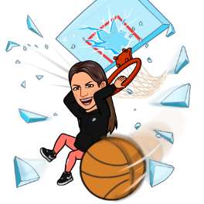

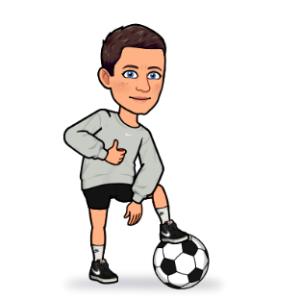





















Physical Education Roadmap
Competition
Interventions to support pupils
Students will be introduced to competition: Intra/Inter Sportsday/School Games/Lessons
The Journey Starts
Fundamental Movement Skills
All students will be baselined on entry to St. Georges school at whatever year they enter
All students identified for additional support with gross & fine motor skills (Enabling/Accessing)
Gymnastics
Will be developed over KS3 Running/Jumping/Throwing/Travelling/Catching/Striking
Students will start to explore and develop different movements, balance and coordination through gymnastics
Key Stage 3
Year 7
Year 8
Hygiene
Students will learn about the importance of Hygiene & Well-being
Year 9
Health
The Body
Swimming
Students will learn about the importance of Healthy Eating, Sleep, Well-being
Students will start to learn about their bodies
Students will access swimming every year in Key stage 3 and 4 and follow the School Swimming and water safety curriculum.
KS4 Games
Competition Increases
Students will explore transferable skills, knowledge & understanding
Students will have opportunity for more sports and quality of competition increases to include local/county opportunities.
The Body
Year 10
Key Stage 4
Students will develop knowledge and understanding about their bodies
Community Clubs and National Fixture Opportunities
All students will be encouraged to join local clubs –Sign-posting in weekly newsletter/Exit Routes
Opportunities are given for students to attend national fixtures and events
Year 11
Leadership
Swimming/UKSA
KS4 students will have opportunity for Sports Leadership within lessons
All pupils will be water confident and develop an understanding of water safety
Strategies, Tactics, Rules, Roles
OAA
Students will develop greater understanding of strategies, tactics and rules for sports. They will take on different roles (e.g. umpire, coach)
Pupils in KS4/5 will have the opportunity to visit different environments for OAA including residential
Key Stage 5
Sports Specific Skills
KS4 students will learn specific sports skills within lessons applying them in different scenarios and related sports
Options
End of KS5
KS5 students can choose to further their experiences within physical education by opting to take part in a community based option, we offer both accredited and non accredited options. They can also choose to follow a leadership pathway and opt into Leadership Skills Foundation accredited option
Students will leave with an understanding of physical activity and sport. The knowledge of local facilities/activities are available to them and how to access them. Allowing all students to understand how to successfully live a healthy and active lifestyle. Some students will have gained skills in leadership which will allow them to access this career path if they desire

