Slide 1


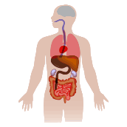
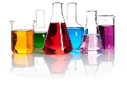
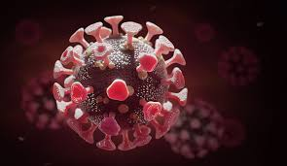


Progression in Science
Sunflower
Colour and Light, Communities and Culture, On the Move
Sunflower access Immersive Science learning with a specialist teacher
KS3 Curriculum
Physics
Forces
Children will problem solve to link the laws of physics with everyday life.
Chemistry
The Journey Starts
All students experience science at KS3
Materials
Children will learn about varied materials and their practical uses.
All students are baselined in science at the start of KS3
Start
Key Stage
3
Year 7
Year 8
Year 9
Biology
Animals and Plants
Children will learn about their natural environment and how to care for it.
Chemical Products Used In The Home
Science: Health and Safety
Scientific Enquiry
Science and The Human Body
Learners will experience the different states of matter and classify materials to help inform their decisions.
Students learn to keep safe, in the lab, at home and in the outside world.
Key Stage 4
Children will have the opportunity to undertake many different scientific enquiries.
Children will learn how to make
the right life choices for their health.
Year 11
Year 10
Specialist Equipment
Children will experience and use the specialist equipment safely.
Sex and Relationship Education
STEM Careers
Eco Schools
This will be taught alongside the
RSHE curriculum.
Children will have access to information on STEM careers. Talks, displays, posters, science festivals/days and during lessons.
St Georges students will have the opportunity to participate in ‘The Eco-Schools programme’ this empowers young people to make a difference in their school, local community and beyond.
Working with Electrical Circuits
Key Stage 5
Year 12
Year 13
Students will learn the basic principles of electrical circuits.
The Science Of Light and Sound
KS5 Environmental Studies
End of KS5
Students will learn the basic science of light and sound and know how light can be used for communication purposes.
Learners will develop their understanding of science from KS4 and link their science knowledge to the IOW ecosystems and industries.
Children will leave with an enquiring mind. They will be able to make some sense of the world around them and look after the planet. Some students may go on to take a science GCSE or other qualifications.

