Slide 1


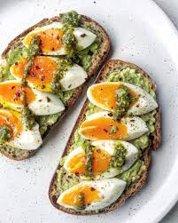






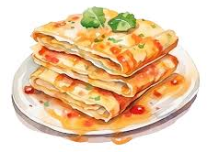



Progression in Food Tech & Hospitality 26-27
Year 7
Introducing students to a food tech room, developing basic kitchen skills and an understanding of food hygiene, health and safety and independence.
Year 8
Learning essential kitchen skills for food preparation and safety to become more independent in the kitchen.
Year 9
Increasing independence and greater understanding of preparing, cooking and storing fresh and frozen ingredients.
Key Stage
3
Year 7
Year 8
Year 9
Key Stage 4 – Home Cooking Essentials QM
KS4 – QM Home Cooking Essentials
Two-Year Programme | Three Pathways
- Immersive: Sensory-based, hands-on cooking to build confidence and engagement.
- Life Skills: Focus on independence, nutrition, and everyday food preparation.
- Vocational: Industry-focused training with café experience, event planning, and Food Safety certification.
Collaborative working Horticulture, Dragon, Science, Art, and Food Technology collaborate to help students explore the connections between subjects and wellbeing.
Key Stage 4
Sunflower
Experiencing and exploring a range of foods through immersive learning.
Developing awareness of likes and dislikes. Developing needs of students through EHCP targets.
HCE
Y2
HCE
Y1
Key Stage 5 – Hospitality Cafe QM – Immersive, Life Skills and Vocational Pathways
KS5 – QM Hospitality Café
Two-Year Programme | Three Pathways
- Immersive: Real-world café experience with sensory engagement and teamwork.
- Life Skills: Develop customer service, presentation, and complaint-handling skills.
- Vocational: Use professional equipment, plan events, and earn Food Safety certification.
Key Stage 5
H&C
Y1
H&C
Y2
H&C
Y3
Key Stage 5 – Hospitality Cookery QM – Immersive, Life Skills and Vocational Pathways
KS5 – QM Hospitality Cookery
Three Year Programme | Three Pathways
- Immersive: Hands-on cooking with sensory exploration and confidence-building.
- Life Skills: Focus on nutrition, communication, and personal development.
- Vocational: Structured kitchen training with real-world routines and certification.

